Slide 1
FHIM MDA Implementation Modeling Process Guide
Developing Standard-specific Implementation Guide for Health IT

Slide 2
FHIM Implementation
Model-driven approach
The model is the basis for generating
Ballot documentation
Software libraries for creating/parsing, validating constraints
Reference implementation (i.e.
Modeling implementation guides based on interoperability use cases
One IG model may be used to create multiple Platform-specific IG artifacts
NIEM-based IEPD
CDA R2 IG → Example provided in this presentation
HL7 FHIR Profiles

Slide 3
Implementation Guide Models based on FHIM
Implementation Guide Model: containing the use cases for interoperability and a profile model:
1. Use Case Package
Interoperability Use case descriptions including pre- and post-conditions for information exchanges.
The use case may identify a specific type of business objects that are involved in the exchange (e.g. Patient, Encounter, Sample, Order, and Observation Result).
Identified human and system actors involved in information exchanges. The systems actors may represent specific types of system. An EHR system may play one or more roles in an interoperability use case

Slide 4
Implementation Guide Models based on FHIM - continued
Implementation Guide Model: containing the use cases for interoperability and a profile model:
2. Implementation Profile Model Package
Snapshots/copies of FHIM classes including:
Focal class(es) corresponding to the focal objects that are the subject of interoperability (e.g. Patient, Encounter, Sample, Order, Observation Result). Related classes that supply context to the focal objects (e.g. target records, author, custodian, ordering provider, etc.)
Including PSM-specific annotations for code generation. This tooling guidance should be added to the original FHIM classes and reused
Constraints applied the classes, associations and attributes in the model including:
Semantic clarifications
Cardinality constraints for associations and attributes
Usage/mandatory constraints for associations and attributes
Terminology and fixed value constraints (these constraint apply to attributes only)

Slide 5
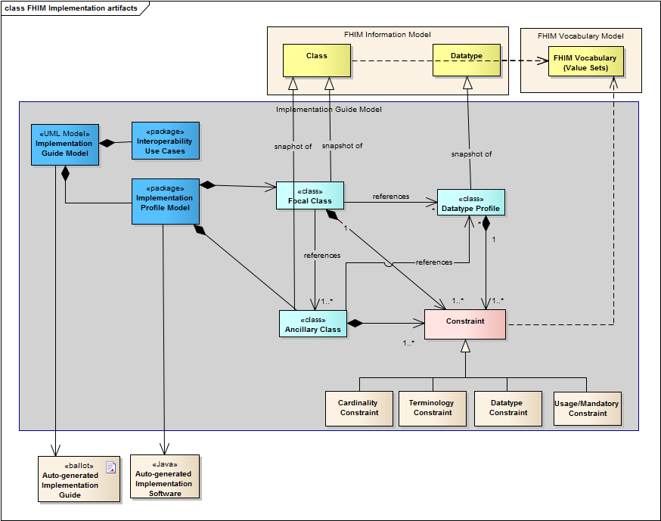
Implementation Guide Modeling Artifacts

Slide 6
Implementation Guide Models
Isolate the data required to implement one or more specific interoperability use cases
Identify the constraints applied to FHIM
Reuse internal mapping information to reference base standards/constructs
Refers to the FHIM vocabulary
Value sets
Identified coding system
Fixed concept codes

Slide 7
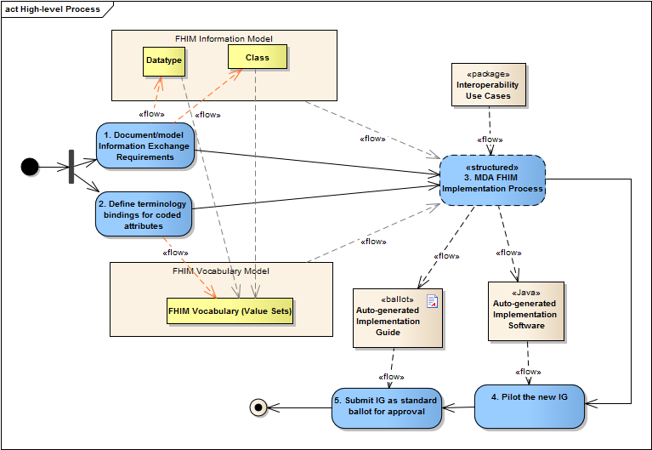
Implementation Process

Slide 8
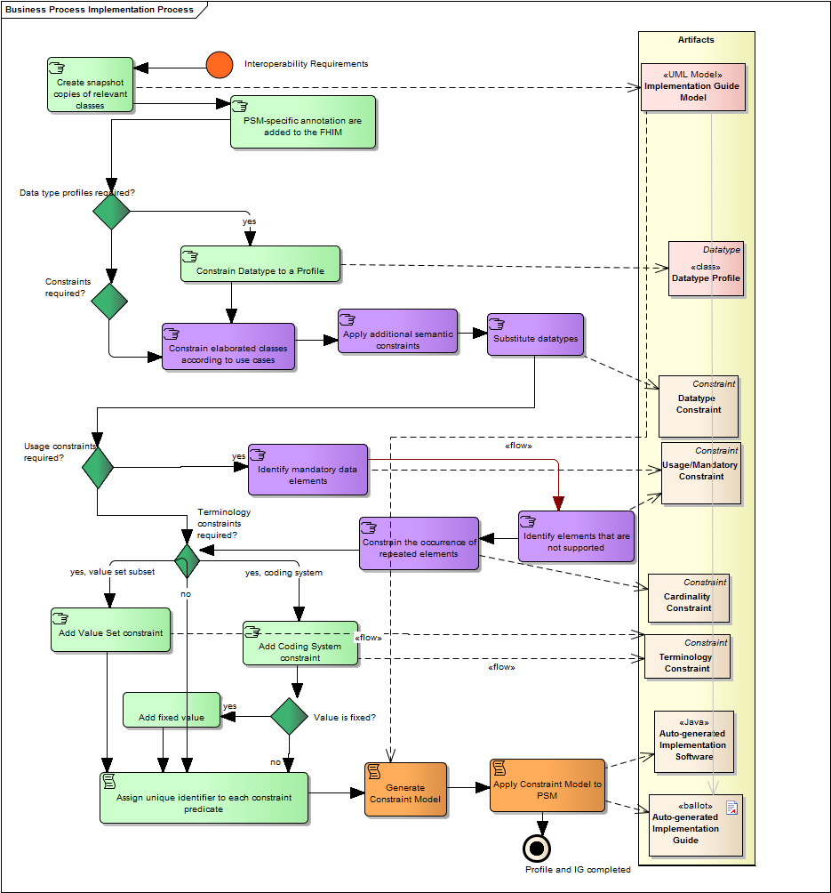
Notes:
Document the information required for exchange in the FHIM Information Model. FHIM is a platform independent model (PIM) model describing the information exchange requirements of FHIM stakeholders. The result of this activity is to create a FHIM UML model organized into packages/domains. Each domain contains the information required to exchange information among systems in a specific business area.
Define terminologies and value sets for coded data attributes in the FHIM Vocabulary model. This FHIM Terminology is a UML model that contains all references to all coding system and value set versions used by coded attributes of FHIM classes. This model will also contain coding system version and subsets used by implementation guides based on FHIM.
Follow a Model Driven Architecture (MDA) process guide to produce a draft implementation guide as described in section 7. The following is a high-level summary of the approach:
Identify the specific use case(s) for exchange of information
Identify the target Platform Specific Model(s) (PSM) to support the exchange
Constrain the FHIM and associated terminologies/value sets to generate a PIM that contains the information needed to support the use case
Use the use case PIM to generate the target PSM
Use the PSM to generate artifacts for the target implementation standard
Pilot test the draft implementation containing constraints and extensions to the base standards in PSM and based directly on the contents of the PIM
Submit the draft implementation guide to an SDO/SRO for ballot/approval; if the project requirements require specific extensions in the base standards (i.e. PSM) additional change requests will be submitted for each extension or gap that needs to be addressed.

Slide 9
Notes:
Document the information required for exchange in the FHIM Information Model. FHIM is a platform independent model (PIM) model describing the information exchange requirements of FHIM stakeholders. The result of this activity is to create a FHIM UML model organized into packages/domains. Each domain contains the information required to exchange information among systems in a specific business area.
Define terminologies and value sets for coded data attributes in the FHIM Vocabulary model. This FHIM Terminology is a UML model that contains all references to all coding system and value set versions used by coded attributes of FHIM classes. This model will also contain coding system version and subsets used by implementation guides based on FHIM.
Follow a Model Driven Architecture (MDA) process guide to produce a draft implementation guide as described in section 7. The following is a high-level summary of the approach:
Identify the specific use case(s) for exchange of information
Identify the target Platform Specific Model(s) (PSM) to support the exchange
Constrain the FHIM and associated terminologies/value sets to generate a PIM that contains the information needed to support the use case
Use the use case PIM to generate the target PSM
Use the PSM to generate artifacts for the target implementation standard
Pilot test the draft implementation containing constraints and extensions to the base standards in PSM and based directly on the contents of the PIM
Submit the draft implementation guide to an SDO/SRO for ballot/approval; if the project requirements require specific extensions in the base standards (i.e. PSM) additional change requests will be submitted for each extension or gap that needs to be addressed.

Slide 10
Federal Health Information Model (FHIM) and Associated Terminology Models
Goal
Produce a logical, health information model that supports semantic interoperability and that is built by harmonizing information from the individual Federal partners and standards organizations
Principles
The model will be expressed in standard Unified Modeling Language (UML) notation (it may also be expressed in other notations)
The model will be designed to meet all Federal partner semantic interoperability needs for the exchange of information with other organizations
The model will support existing national health standards
The model will be in the public domain, freely available and easy to access
The model will be specified as a logical model consisting of a set of domain models
The model will not specify behaviors (operations) and, at least initially, will not specify OCL constraints or rules
The model will be made available as an XMI export

Slide 11
Federal Health Information Model (FHIM) and Associated Terminology Models
Initial baseline model created by drawing on existing UML models from VHA, NCI and FDA
HL7 Reference Information Model (RIM) used as a reference model for the FHIM
Developed using a standard process and style guide
Lead FHIM modeler ensures consistency, integration and harmonization across domain models
Health information divided into domains (e.g., Person, Laboratory, Medications/Pharmacy, etc.) - each domain has a modeling team
Modeling team consists of lead modeler, SMEs, Federal partner liaisons, others
Model each domain starting with existing information from baseline model
Incorporate and harmonize information from Federal partners
Incorporate and harmonize information from standards organizations
Model is versioned and stored in a GForge repository as it is developed
Model is distributed for review/feedback by Federal partners

Slide 12
Federal Health Information Model (FHIM) and Associated Terminology Models
FHIM links to terminology models/value sets by storing a unique value set ID
Terminology models maintain all other terminology information
FHIM maintains traceability to use cases and the HL7 EHR-S Functional Model
FHIM incorporates information from Computational Independent Models (CIMs)
FHIM is a Platform Independent Model (PIM)

Slide 13
Benefits of Information Modeling Project Information and Terminology Models
The models retain use case context
The models are integrated (2-way links between Information Terminology models)
The modeling process harmonizes content (information and terminology) across organizations
The models support efficient standards development
The models are being integrated with the MDHT to support a model-driven approach to development of information exchange interoperability specifications
The models can be leveraged by organizations for internal use in systems and database development
The models are developed using standard UML

Slide 14
Terminology Binding Summary
Freely available harmonized information and terminology models
Integrated with open source model-driven health tools
That can support multiple implementation platforms (PSMs), including NIEM
And that support the goals and requirements of the S&I Framework

Slide 15
Model-driven Constraints in FHIM
Model-Driven Health Tools (MDHT) Examples

Slide 16
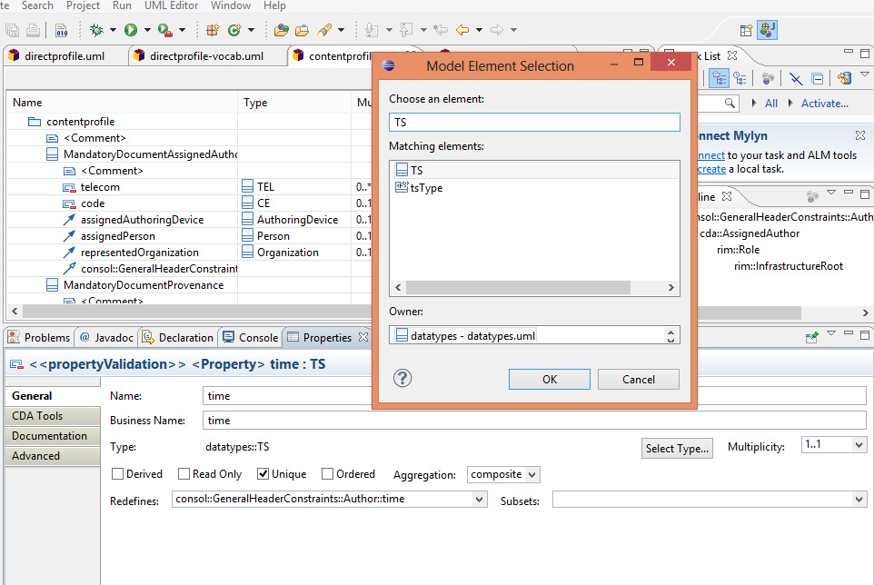
Data type constraint

Slide 17
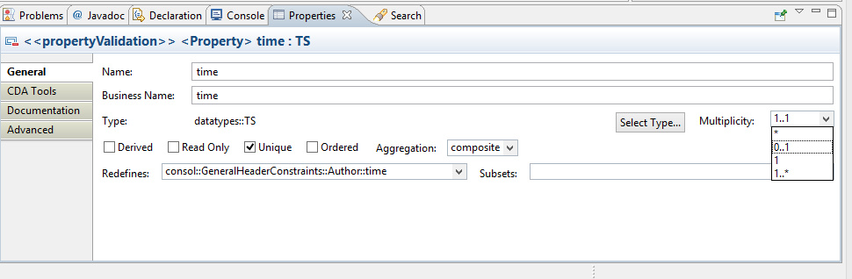
Cardinality constraints

Slide 18
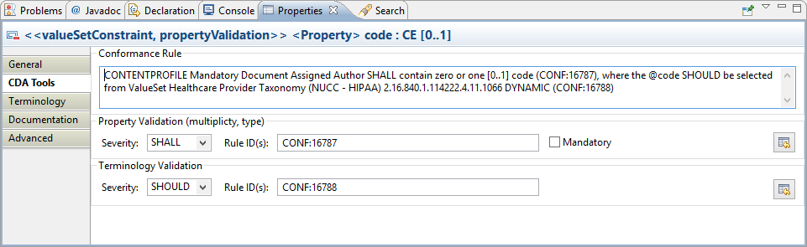
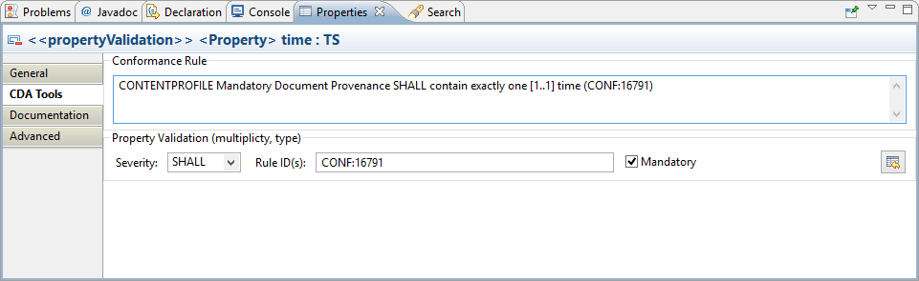
Data element usage and terminology constraints

Slide 19
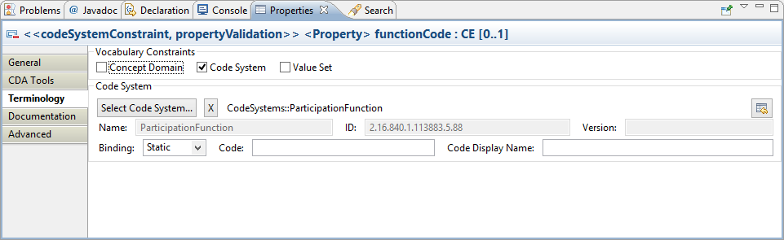
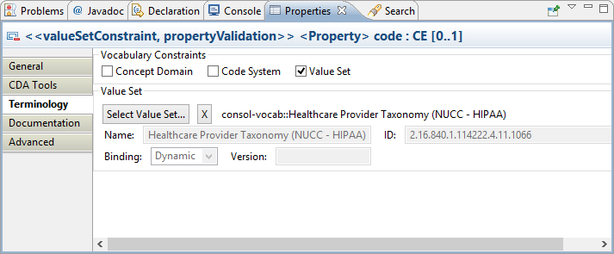
Code system vs. Value Set constraints

Slide 20
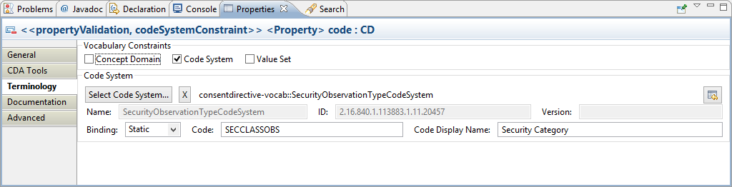
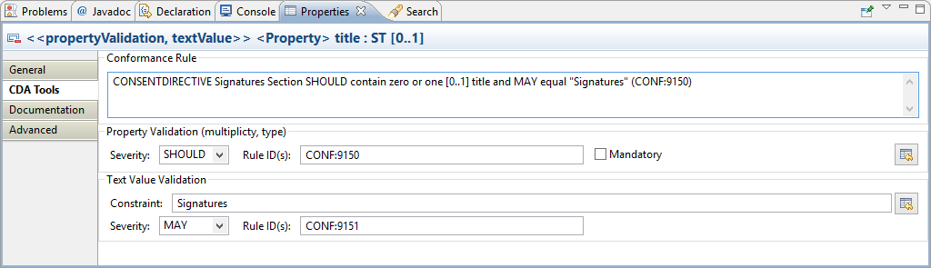
Fixed value constraints

Slide 21
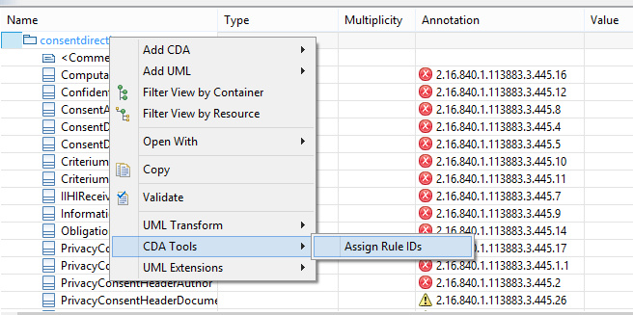
Unique Identifiers for templates

Slide 22
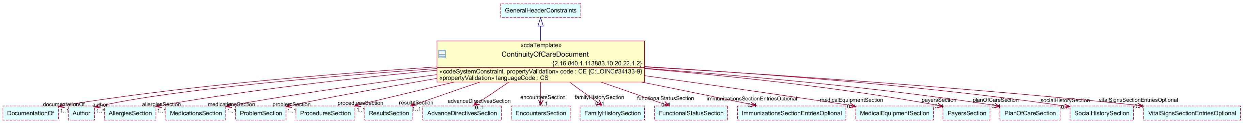
CDA PSM Overview

Slide 23
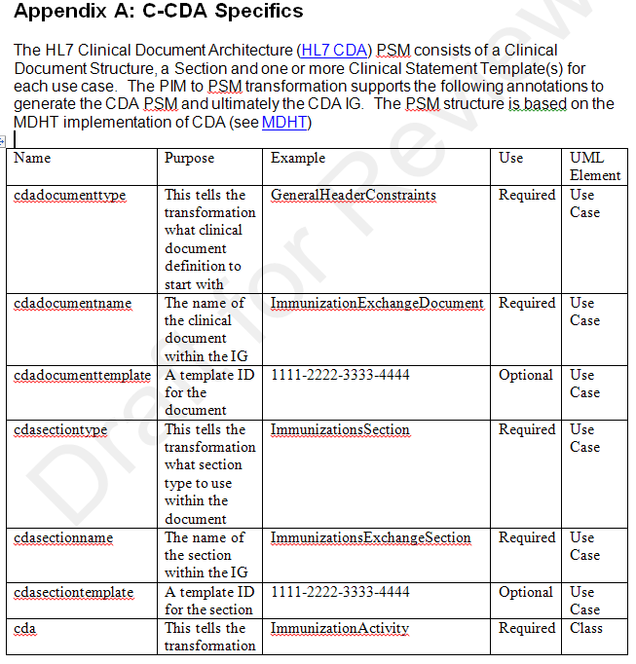
CDA R2 Metamodel
CDA templates
Header
Section
Clinical templates
Observation
Problems
Immunization example in Appendix A

Slide 24
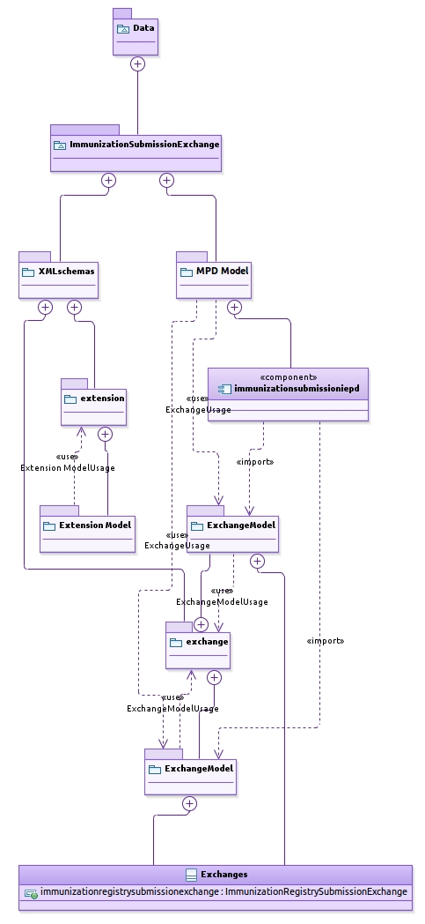
NIEM PSM Example
Appendix B
Exchange module
Constraint module
Extension module

Slide 25
FHIM-based Constraint Model
Information Model
Terminology constraints
Data Elements
Mandatory
Cardinality
References the appropriate underlying standard
RIM Class
HL7 Version 2 segment
Coding system
Value Set binding

Slide 26
Implementation Process

Slide 27
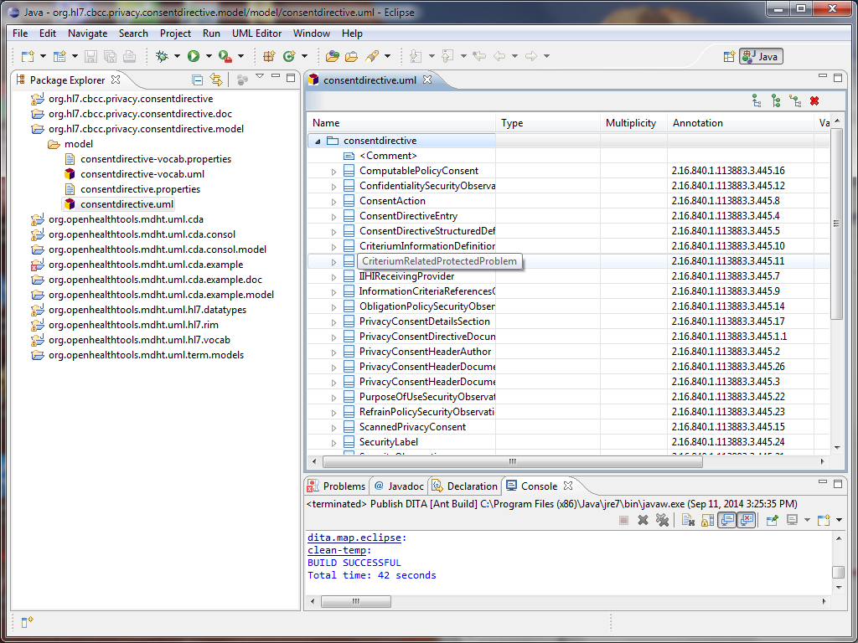
Auto-generated constraint model in MDHT – CDA IG Example
Auto-generated Java Code
DITA Document Generation
Implementation Guide Model
Template

Slide 28
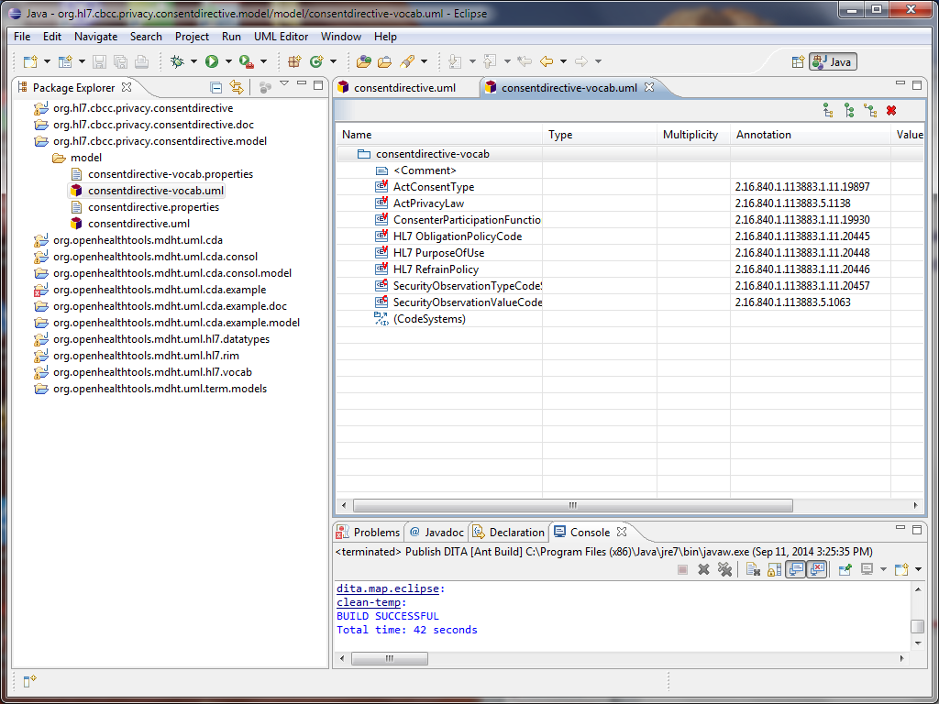
Value set binding in FHIM result in terminology constraints in CDA
Value Set Binding
Implementation Guide Vocabulary Constraint Model
Implementation Guide Info/Structural Constraint Model

Slide 29
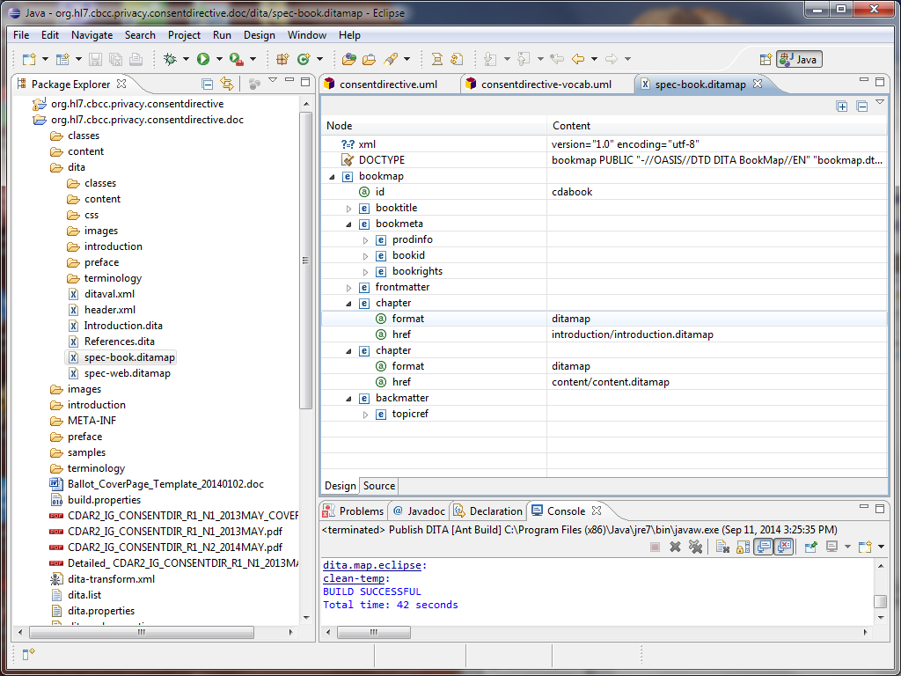
Documentation Management
Document template
Document template

Slide 30
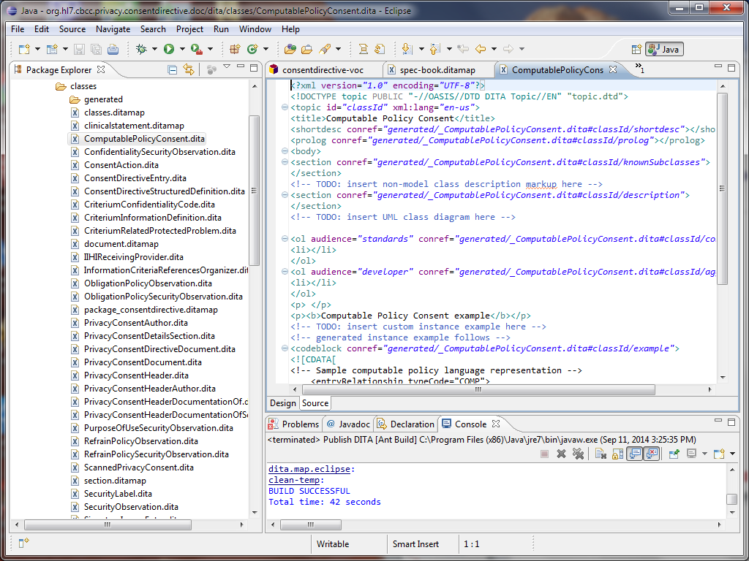
Template-specific documentation including constraints
Auto-generated documentation

Slide 31
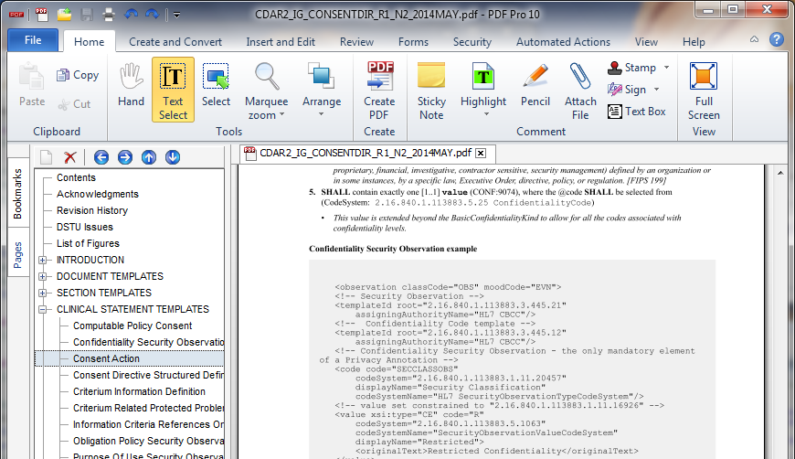
Documentation Generation using DITA
Auto-generated documentation rendered in PDF

Slide 32
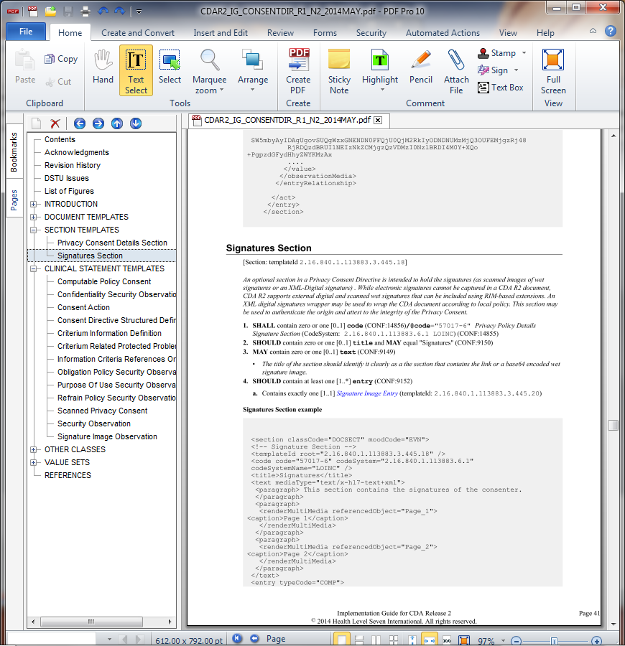
Constraints (structural, vocab) rendered in PDF

Slide 33
Auto-generated Java code
Based on
Underlying based standard model
Adding IG-specific constraints
Java library
To instantiate CDA document conformant with the IG
To parse and validate content

Slide 34
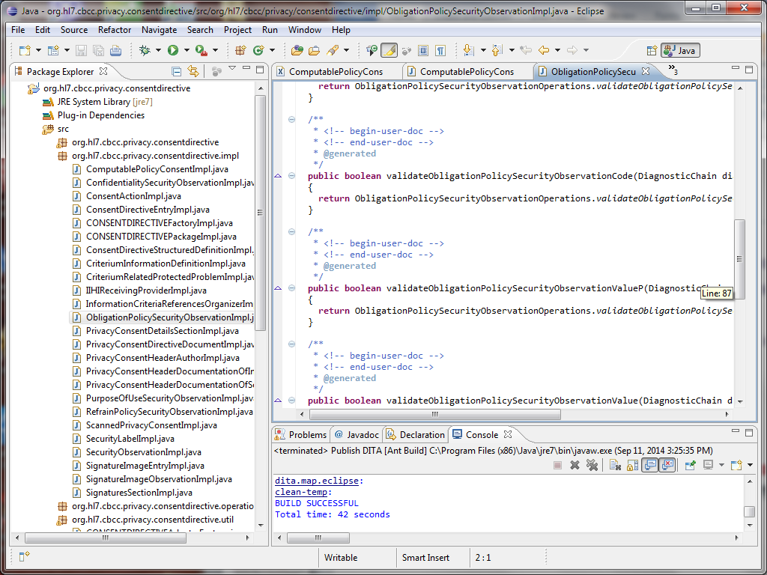
Constraints (structural, vocab) expressed as validation/parsing/ instance creation API

Slide 35
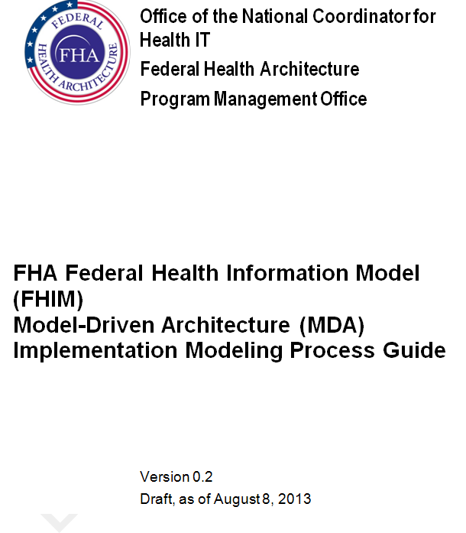
Implementation Guide Documentation
https://www.projects.openhealthtools.org/sf/projects/fhims/

Slide 36
Questions Discussion
FHIM Implementation documentation
IG development Tooling
Code generation
Document/ballot generation

